Slide 1
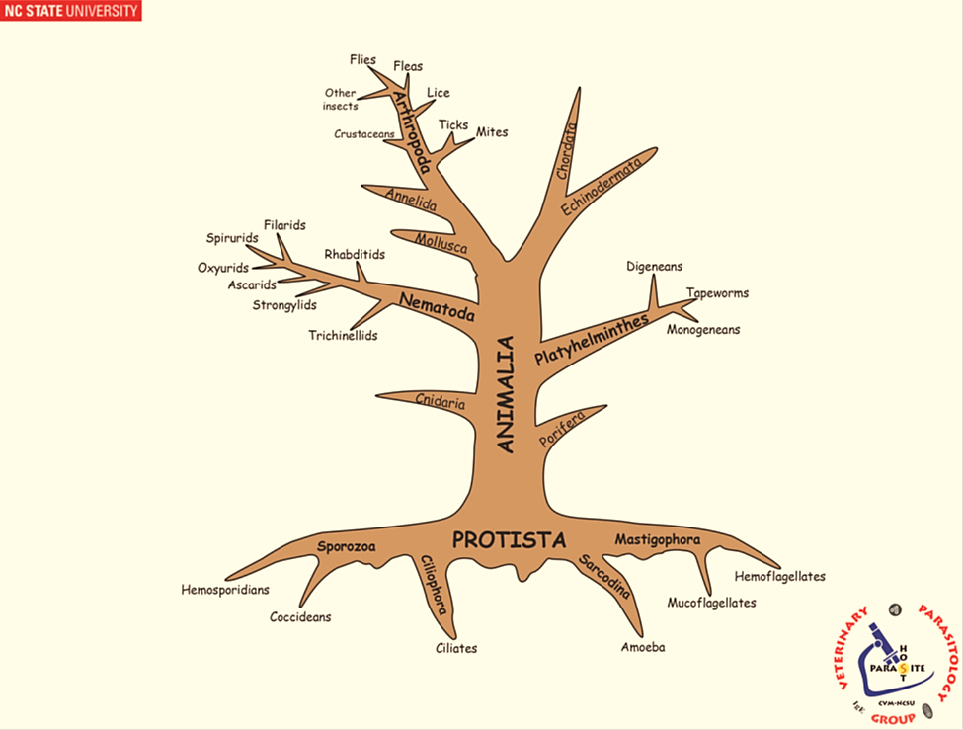
INTRODUCTION TO PLATYHELMINTHES SYSTEMATIC

Slide 2
Characteristics of the Phylum Platyhelminthes:
Platyhelminthes one of the most important phylum with thousands genus at the world, the general characteristics:
1. bilaterally symmetrical; dorso-ventrally flattened
2. A celomate
3. cannot synthesize fatty acids
4. tegument (living external layer)
5. digestive tract incomplete or absent
6. excretory system protonephridia

Slide 3
The phylum Platyhelminthes consists of four classes:
1. CLASS: Turbellaria
mainly free-living flatworms, some as symbionts associated with echinoderms, molluscs, fish, cnidarians, etc. Although the majority are thought to be commensals, some are truly parasitic, few are commensals or parasites of invertebrates, free-living examples include Planaria spp. in aquatic environments and the giant terrestrial land planaria in the genus Bipalium spp.; commensal/parasitic forms include Syndesmis spp. in the intestines of sea urchins, Bdelloura spp. on the gills of horseshoe crabs, and Stylochusfrontalis in the valves of oysters.

Slide 4
2. CLASS: Monogenoidea (Monogenea)
All parasitic, most species on fish gills or skin; however, some internal in urinary bladder, nasal passages, cloaca, one host life-cycles, evolutionarily, appears to be more closely related to cestodes than trematodes, with two main "traditional" subclasses for this class:
1. Subclass: Monopisthocotylea
2. Subclass: Polyopisthocotylea
3. CLASS: Trematoda
All parasitic, mainly in digestive tract, most with suckers, most with 2-more host life cycles, with three subclasses:
1. Subclass: Digenea (typical flukes)
2. Subclass: Aspidogastrea

Slide 5
3. Subclass: Didymozoidea
4. CLASS: Cestoidea
All parasitic; tapeworms, most with 2-more host life cycles, no digestive tract, most segmented.
Class: Monogenea
The general characteristics of class Monogenea as below:
1. hermaphrodites
2. normally ectoparasites on aquatic vertebrates
3. generally site specific on host and host specific
4. live a few days - years, depending on species

Slide 6
5. morphologically: Prohaptor (sometime present, anterior end that may bear adhesive or feeding organs). Eyespots sometime present, photoreceptors near two anterior ganglia. The tegument (living external layer).
Alimentary tract consist of:
1. mouth anterior, usually with Prohaptor
2. esophagus with muscular pharynx
3. intestine branches into cecae, often with diverticula
4. Monopisthocotylea feed mainly on epidermis and mucus; Polyopisthocotylea mainly on blood, host cells, and mucus
5. blind-ended gut, regurgitate waste

Slide 7
Protonephridia [excretion] consist of:
1. 2 main lateral ducts, extend posteriorly; then curve and extend anteriorly
2. contractile bladders laterally
3. flame cells drive fluid within ducts
Reproductive systems consist of:
- Male : 1-200 testes (1-2 most common), testes - vas efferent - vas deferens - seminal vesicle - cirrus - gonopore; sometimes prostate

Slide 8
- Female : 1 ovary, normally anterior to testes, oviduct from ovary – ootype, Mehlis gland lubricates uterus, forms egg shell capsule, genito intestinal canal, only in Polyopisthocotylea; connects oviduct with right intestinal caecum for excess secretions discharge, 0-2 vaginas - sperm transfer; if none, use gonopore, sometimes a seminal receptacle, vitellarial secretions add to egg-shell formation; ducts fuse near oviduct, eggs pass through uterus, out gonopore; sometime a muscular metraterm.
Development :
- eggs shed, normally with filaments, filaments stick to host
- oncomiracidium ciliated, hooked posteriorly, about a 24 hr life, if eyespots, phototactic, some attracted to fish mucus, grow to adult directly

Slide 9
Opisthaptor which may be:
- suckers ( =suckerlets)
- anchors (large hooks, sometimes called hamuli or central hooks)
- hooklets (left over larval hooks, sometimes called marginal hooks)
- bars (often called accessory sclerites; they support anchors)
- clamps (complex, muscular structures more advanced than suckers).

Slide 10
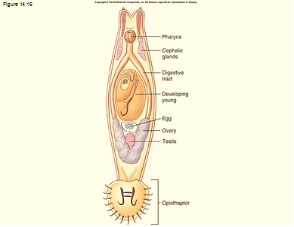

Slide 11
Monogenea typically occur at low levels on fish and so do not inflict serious harm. However, in fish farms, infestations may become very heavy and lead to significant mortality.

